Slide 1
EMNLP 16 Workshop on Structured Prediction for NLP Austin Nov 5. 2016
Kai-Wei Chang
University of Virginia
Ming-Wei Chang
Microsoft Research
Alexander Rush
Harvard University
Vivek Srikumar
University of Utah

Slide 2
Why structured prediction
NLP problems are structural
Output variables are inter-correlated
Need joint predictions
Traditional approaches
Graphical model approaches
E.g., Probabilistic graphical models, structured perceptron
Sequence of decisions
E.g., incremental perceptron, L2S, transition-based methods

Slide 3
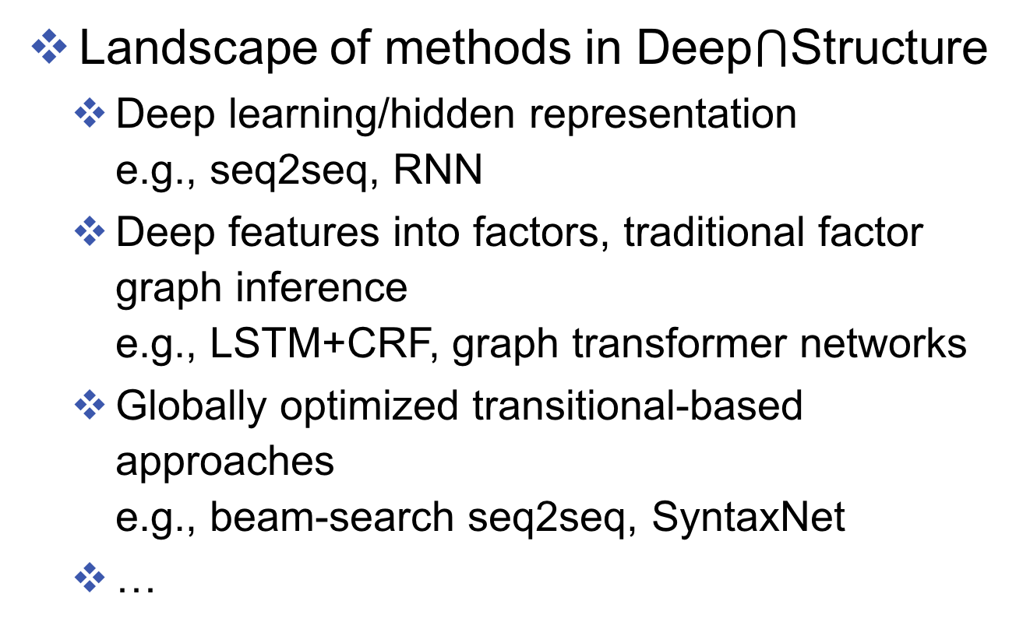
Recent trends
Landscape of methods in Deep$⋂$Structure
Deep learning/hidden representation e.g., seq2seq, RNN
Deep features into factors, traditional factor graph inference e.g., LSTM+CRF, graph transformer networks
Globally optimized transitional-based approaches e.g., beam-search seq2seq, SyntaxNet
…

Slide 4
Core issues
What is the right way to encode structures?
Empirical/theoretical performance analysis
How to implement?
e.g., programming abstraction, hardware, etc.
What should I teach in my next “machine learning for NLP” course?
Do we still need structured approaches?
When/where structures are needed?

Slide 5

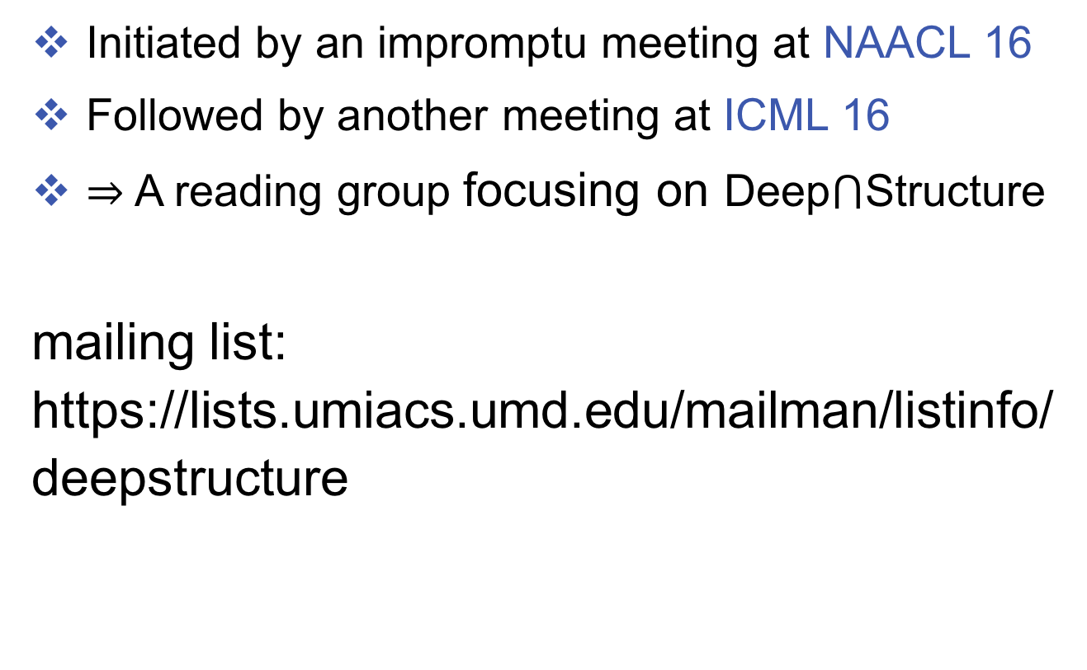
Deep$⋂$Structure Reading Group
Initiated by an impromptu meeting at NAACL 16
Followed by another meeting at ICML 16
$⇒$ A reading group focusing on Deep$⋂$Structure
mailing list: https://lists.umiacs.umd.edu/mailman/listinfo/deepstructure

Slide 6
Why this workshop?
Venue to discuss these core issues
Invite people outside core NLP
ML, CV, Deep learning, Robotics
Finding new test-beds
More parsing?
Reevaluate conventional wisdom

Slide 7
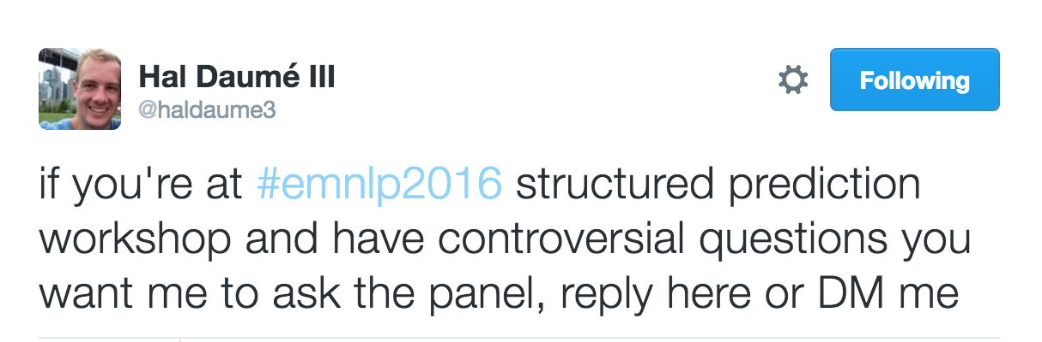
Panel:
Moderator: Hal Daumé Il
Panelists:
Yejin Choi
University of Washington
Sebastian Riedel
UCL
Noah Smith
University of Washington
Dzmitry Bahdanau University of Montreal

Slide 8


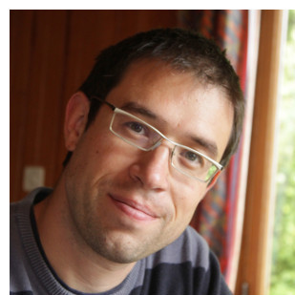
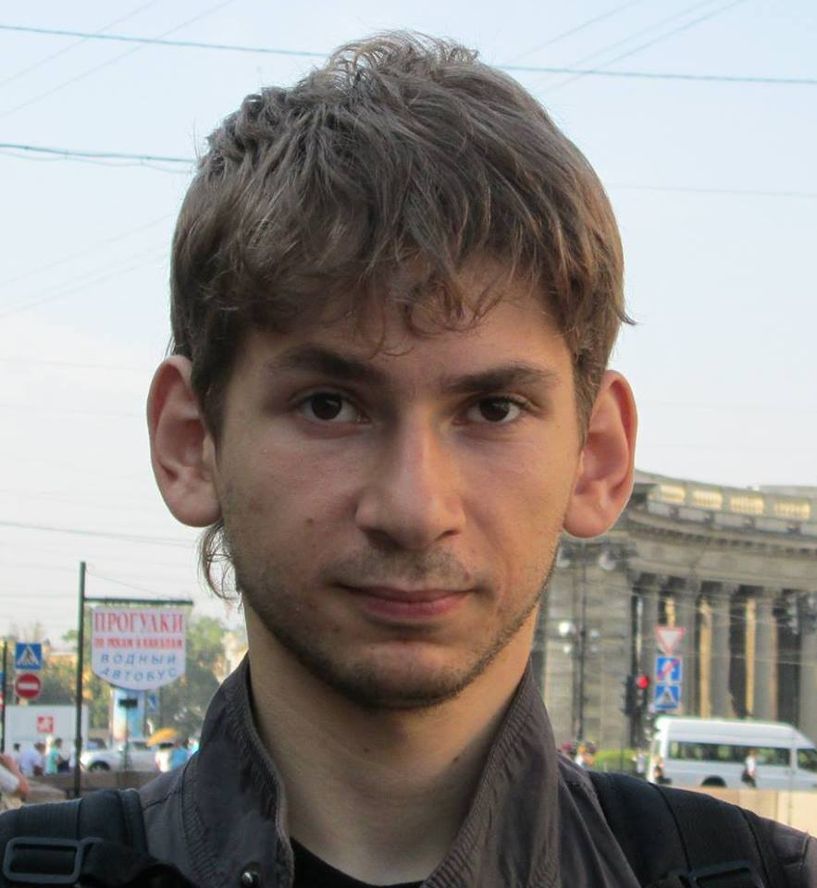
Invited talks
Kristina Toutanova Microsoft Research | Dhruv Batra Georgia Tech | David Grangier Facebook | Dzmitry Bahdanau University of Montreal

Slide 9
Contributed Talks/Posters
Paper | Authors
Unsupervised Neural Hidden Markov Models | Ke M. Tran, Yonatan Bisk, Ashish Vaswani, Daniel Marcu, and Kevin Knight
Inside-Outside and Forward-Backward Algorithms Are Just Backprop | Jason Eisner
Research on attention memory networks as a model for learning natural language inference | Zhuang Liu, Degen Huang, Jing Zhang, and Kaiyu Huang
Joint Model of Rhetorical Discourse Structure and Summarization | Naman Goyal and Jacob Eisenstein
Posterior regularization for Joint Modeling of Multiple Structured Prediction Tasks | Karthik Goyal and Chris Dyer
A Study of Imitation Learning Methods for Semantic Role Labeling | Travis Wolfe, Mark Dredze, and Benjamin Van Durme
Introducing DRAIL -- a Step Towards Declarative Deep Relational Learning | Xiao Zhang, Maria Leonor Pacheco, Chang Li, and Dan Goldwasser
The Structured Weighted Violations Perceptron Algorithm | Rotem Dror and Roi Reichart

Slide 10
Schedule: morning
9:00–9:15: | Welcome
9:15–10:00: | Invited Talk: Kristina Toutanova
10:00–10:30: | Contributed Talk: Jason Eisner
10:30–11:00: | Coffee Break
11:00–11:45: | Invited Talk: Dhruv Batra
11:45–12:30: | Panel: Moderator - Hal Daumé III

Slide 11
Schedule: afternoon
Please set up the posters during lunch time.
14:00–15:00: | Posters
15:00–15:30 | David Grangier
15:30–16:00: | Coffee Break
16:00–16:45: | Invited Talk: Dzmitry Bahdanau
16:45–17:15: | Contributed Talk: Yonatan Bisk
17:30: | Closing

Slide 12
Thanks for committee members’ support
Amir Globerson | Matt Gormley
Andre Martins | Michael Collins
Chris Dyer | Mohit Bansal
Dan Roth | Ofer Meshi
David Sontag | Ryan McDonald
Hal Daumé III | Scott Yih
Ivan Titov | Sebastian Riedel
Janardhan Rao Doppa | Shay Cohen
Jason Eisner | Yoav Artzi
Kevin Gimpel | Yuan Zhang
Luke Zettlemoyer | Tao Lei

Slide 13
Next year
2nd Workshop on Structured Prediction for NLP
EMNLP 2017 @ Copenhagen, Denmark

